Slide 1
GRAPH
LECTURE # 10

Slide 2
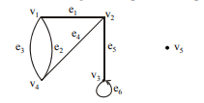

INTRODUCTION:
Graph theory plays an important role in several areas of computer
science such as:
• switching theory and logical design
• artificial intelligence
• formal languages
• computer graphics
• operating systems
• compiler writing
• information organization and retrieval.
GRAPH:
A graph is a non-empty set of points called vertices and a set of line segments joining
pairs of vertices called edges.
Formally, a graph G consists of two finite sets:
(i) A set V=V(G) of vertices (or points or nodes)
(ii)A set E=E(G) of edges; where each edge corresponds to a pair of vertices.

Slide 3
Undirected Graphs
pseudographs
multigraphs
simple graphs

Slide 4
A simple graph
SET OF VERTICES
A simple graph
V = { Chicago, Denver, Detroit, Los Angeles,
New York, San Francisco, Washington }
Detroit
New York
San Francisco
Chicago
Denver
Washington
Los Angeles
SET OF EDGES
E = { {San Francisco, Los Angeles}, {San Francisco, Denver},
{Los Angeles, Denver}, {Denver, Chicago},
{Chicago, Detroit}, {Detroit, New York},
{New York, Washington}, {Chicago, Washington},
{Chicago, New York} }
How many vertices? How many edges?
4

Slide 5
A simple graph
Detroit
New York
San Francisco
Chicago
Denver
Washington
Los Angeles
The network is made up of computers and telephone lines between computers.
There is at most 1 telephone line between 2 computers in the network.
Each line operates in both directions.
No computer has a telephone line to itself.
These are undirected edges,
each of which connects two distinct vertices, and no two edges connect the same pair of vertices.

Slide 6
Multiple Graph
A Non-Simple Graph
Definition 2. In a multigraph G = (V, E) two or more edges may connect the same pair of vertices.
Detroit
New York
San Francisco
Chicago
Denver
Washington
Los Angeles
Two edges are called multiple or parallel edges
if they connect the same two distinct vertices.
THERE CAN BE MULTIPLE TELEPHONE LINES
BETWEEN TWO COMPUTERS IN THE NETWORK.
6

Slide 7
Loops
Detroit
New York
San Francisco
Chicago
Denver
Washington
Los Angeles
An edge is called a loop
if it connects a vertex to itself.

Slide 8
A Pseudograph
Another Non-Simple Graph
Definition 3. In a pseudograph G = (V, E) two or more edges may connect the same pair of vertices, and in addition, an edge may connect a vertex to itself.
THERE CAN BE TELEPHONE LINES IN THE NETWORK
FROM A COMPUTER TO ITSELF (for diagnostic use).
Detroit
New York
San Francisco
Chicago
Denver
Washington
Los Angeles
8

Slide 9
A Directed Graph
Definition 4. In a directed graph G = (V, E) the edges are ordered pairs of (not necessarily distinct) vertices.
SOME TELEPHONE LINES IN THE NETWORK
MAY OPERATE IN ONLY ONE DIRECTION .
Those that operate in two directions are represented
by pairs of edges in opposite directions.
Detroit
New York
Chicago
San Francisco
Denver
Washington
Los Angeles

Slide 10
A Directed Multigraph
Definition 5. In a directed multigraph G = (V, E) the edges are ordered pairs of (not necessarily distinct) vertices, and in addition there may be multiple edges.
THERE MAY BE SEVERAL ONE-WAY LINES
IN THE SAME DIRECTION FROM ONE COMPUTER
TO ANOTHER IN THE NETWORK.
Detroit
New York
Chicago
San Francisco
Denver
Washington
Los Angeles

Slide 11
Types of Graphs
TYPE EDGES MULTIPLE EDGES LOOPS
ALLOWED? ALLOWED?
Simple graph Undirected NO NO
Multigraph Undirected YES NO
Pseudograph Undirected YES YES
Directed graph Directed NO YES
Directed multigraph Directed YES YES

Slide 12
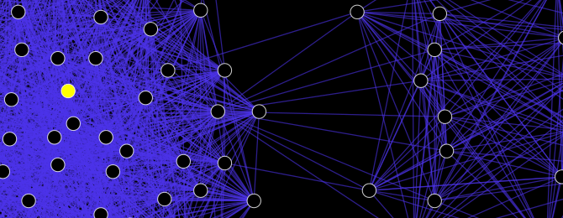
Types of Graph
1. Social network graph
2. Web graph
3.Collaboration Graph
4.Road maps

Slide 13
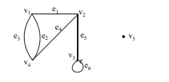
SOME TERMINOLOGY:
1. An edge connects either one or two vertices called its endpoints (edge e1 connects
vertices v1 and v2 described as {v1, v2} i.e v1 and v2 are the endpoints of an edge e1).
2. An edge with just one endpoint is called a loop. Thus a loop is an edge that connects a
vertex to itself (e.g., edge e6 makes a loop as it has only one endpoint v3).
3. Two vertices that are connected by an edge are called adjacent; and a vertex that is
an endpoint of a loop is said to be adjacent to itself.
4. An edge is said to be incident on each of its endpoints(i.e. e1 is incident on v1 and v2 ).
5. A vertex on which no edges are incident is called isolated (e.g., v5)
6. Two distinct edges with the same set of end points are said to be parallel (i.e. e2 & e3).

Slide 14
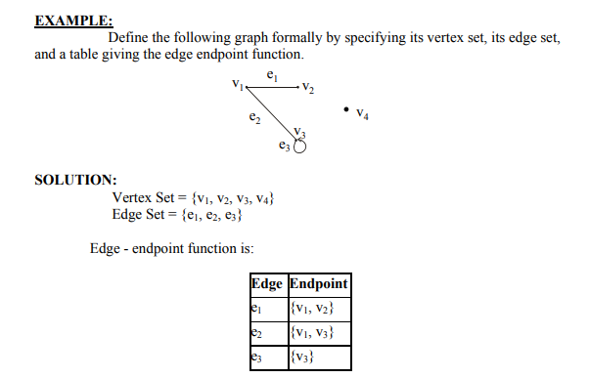

Slide 15
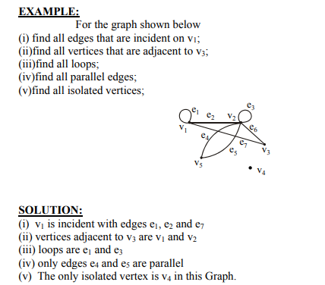

Slide 16
Handshaking Theorem
Theorem 1. Let G = (V, E) be an undirected graph G with e edges. Then
∑ deg( v ) = 2 e
v ε V
“The sum of the degrees over all the vertices equals twice the number of edges.”
NOTE: This applies even if multiple edges and loops are present.

Slide 17
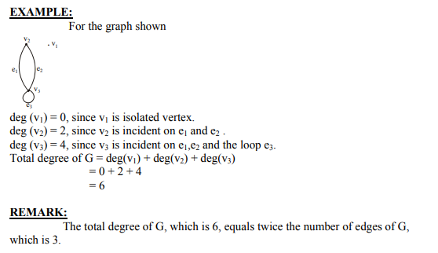
DEGREE OF A VERTEX:
Let G be a graph and v a vertex of G. The degree of v, denoted deg(v), equals the number of edges that are incident on v, with an edge that is a loop counted twice.
Note:
(i)The total degree of G is the sum of the degrees of all the vertices of G.
(ii) The degree of a loop is counted twice.

Slide 18
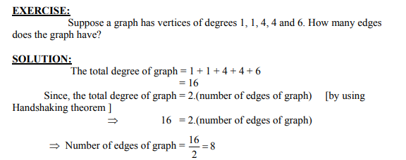

How many edges are there in a graph with 10 vertices each of degree six?
Solution: Because the sum of the degrees of the vertices is 6 · 10 = 60, it follows that 2m = 60
M=60/2
where m is the number of edges. Therefore, m = 30.

Slide 19
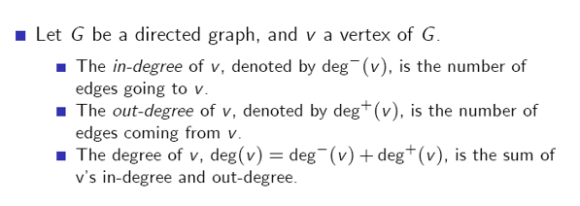

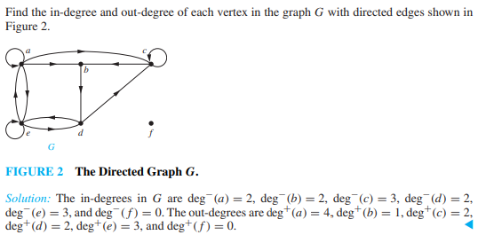

Slide 20
C₅ is a subgraph of K₅
Definition 6. A subgraph of a graph G = (V, E) is a graph H = (W, F) where W ⊆ V and F ⊆ E.
K₅
C₅

Slide 21
W₅ is the union of S₅ and C₅
Union
Definition 7. The union of 2 simple graphs G₁ = ( V₁ , E₁ ) and G₂ = ( V₂ , E₂ ) is the simple graph with vertex set V = V₁ ∪ V₂ and edge set E = E₁ ∪ E₂ . The union is denoted by G₁ ∪ G₂ .
c
b
d
c
c
f
a
e
c
b
d
f
S₅
a
b
d
a
e
e
W₅
a
e
C₅
21

Slide 22
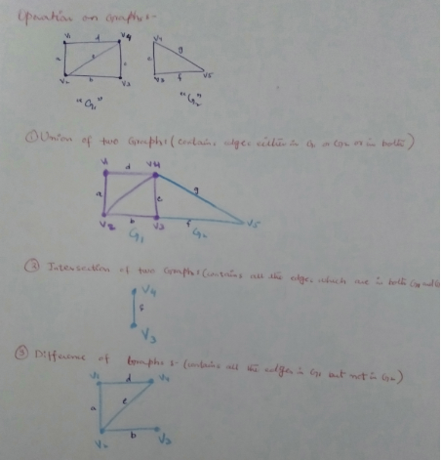

Slide 23
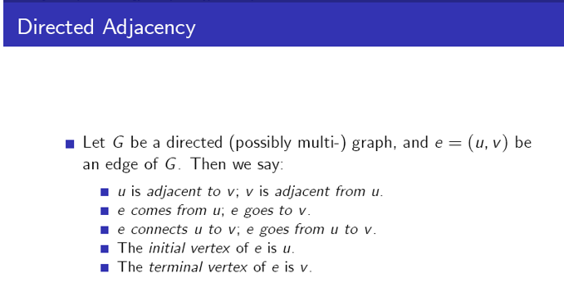
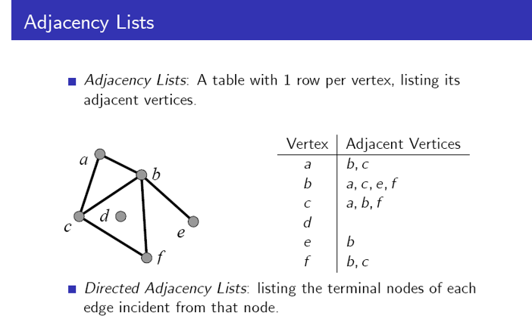

Slide 24
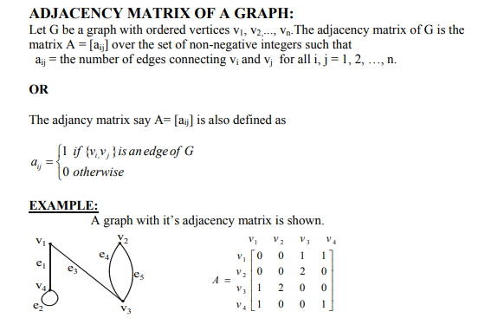

Slide 25
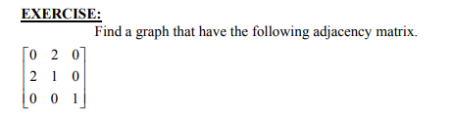
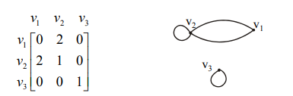
SOLUTION:
Let the three vertices of the graph be named v1, v2 and v3. We label the adjacency matrix across the top and down the left side with these vertices and draw the graph accordingly(as from v1 to v2 there is a value “2”,it means that two parallel edges
between v1 and v2 and same condition occurs between v2 and v1 and the value “1” represent the loops of v2 and v3 ).

Slide 26
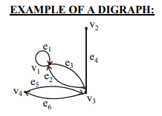
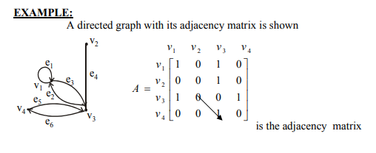
DIRECTED GRAPH:
A directed graph or digraph, consists of two finite sets: a set V(G) of vertices and a set D(G) of directed edges, where each edge is associated with an ordered pair of vertices called its end points.
If edge e is associated with the pair (v, w) of vertices, then e is said to be the directed edge from v to w and is represented by drawing an arrow from v to w.

Slide 27
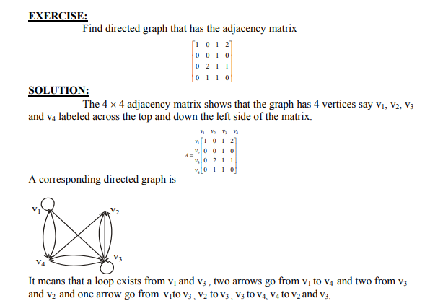

Slide 28
